Slide 1
JDS-5
Java Design Studio - 5
Instructor
Ryan Liu
dio.ryanliu@Hotmail.com

Slide 2
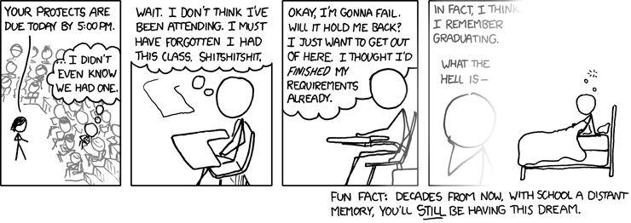
Homework
Homework for next class
Project Progress
Notes:
5 problems of difficulty “easy” from https://leetcode.com/problemset/all/
Trello progress
Github progress
Ask about project progress
Check if they have achieved their goals and if they have not, ask them why not
4 people in 30 minutes -> 7.5 minutes each

Slide 3
GitHub Part 2
Progress … ?
Branches
Merge and Merge Conflicts
Removing Commits or entire pushes
Pull Requests

Slide 4
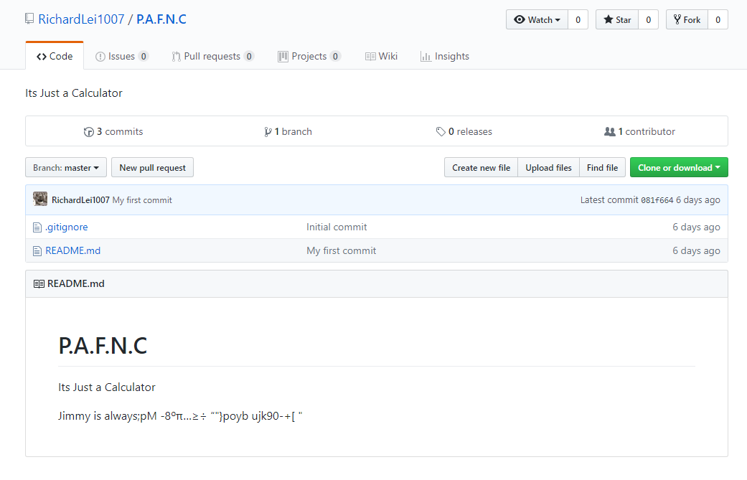
Progress?

Slide 5
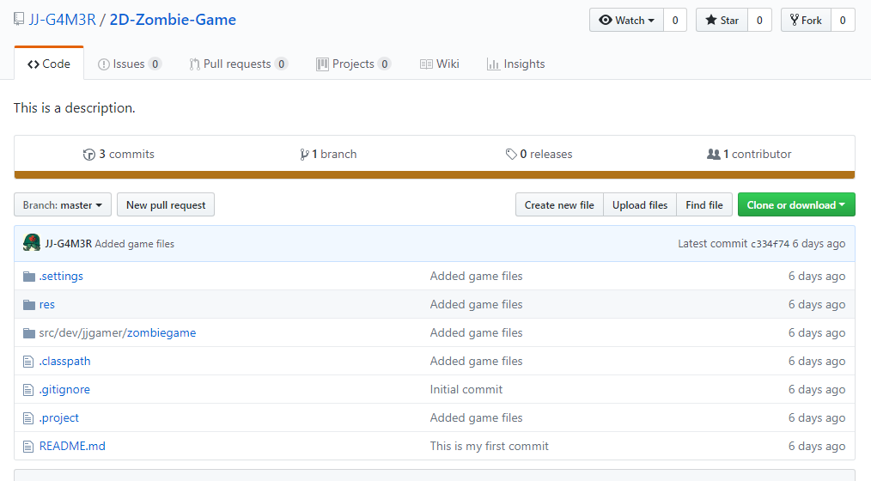
Progress?

Slide 6
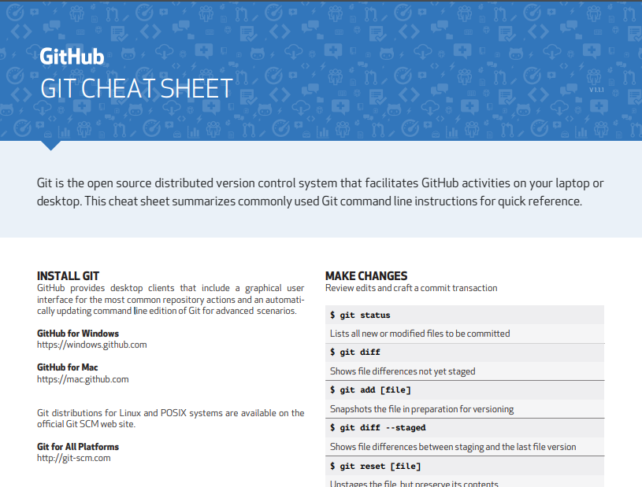
Cheat Sheet
Notes:
https://services.github.com/on-demand/downloads/github-git-cheat-sheet.pdf

Slide 7
More Homework
Continue Trello
Continue project
Push code to GitHub

